Slide 1
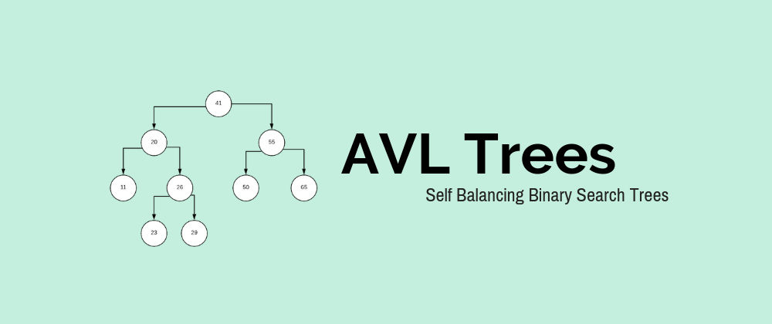
Avl Trees Application
N Hemanth Srivathsav---> (2010030113)
Jyothin movva --->(2010030071)
P.Vivek Vardhan reddy---> (2010030124)
Vishaladitya Valluru---> (2010030493)

Slide 2
BACKGROUND OF THE PROJECT
Understanding the working of Avl trees.
It’s advantage over Binary Tree.
Understanding its self balancing capability.

Slide 3
INTRODUCTION
AVL Tree is invented by GM Adelso- Velsky and EM Landis in 1962. The tree is named AVL in the honours of its inventors.
AVL Tress can be defined as height balanced binary search tree in which each node is associated with a balance factor which is calculated by subtracting the height of its right sub-tree from that of its left sub-tree.
Tree is said to be balanced if balance factor of each node is either -1, 0 or 1 ,otherwise the trees will be unbalanced and need to be balanced.
As it is also a binary search tree therefore it will have all the operations which a binary search tree performs(insertions,deletions). These operations leads to violation in the Avl tree property, therefore balancing must be done.

Slide 4

Rotations in AVL Trees
There are basically four types of rotations which are LL,RR,LR,RL.
RR(Right-Right) Rotation→ RR is applied when a node is inserted into the right subtree of its parent right subtree which makes the balance factor -2.
LL(Left-Left) Rotation→ LL is applied when a node is inserted into the left subtree of its parent left subtree which makes the balance factor 2.
LR(Left-Right) Rotation→ LR has double rotation(LL rotation+RR rotation) i.e first LL rotation is performed on subtree and then RR rotation is performed on that full tree.
RL(Right-Left) Rotation→ RL it also has double rotation(RR rotation+LL rotation) vice-versa of LR rotation. First RR rotation is performed on subtree and then LL rotation is performed on that full tree.

Slide 5
Advantages
The Height Of the AVL tree is always balanced.
The height never grows beyond log N, where N is the total number of nodes in tree
It gives better time complexity as compared to simple Binary search tree
AVL trees have self-balancing capabilities.

Slide 6
Disadvantages
The code for AVL tree is more complex than BST.
The deletion operation is bit hard process as it involve a lot of pointer changes and rotaions

Slide 7
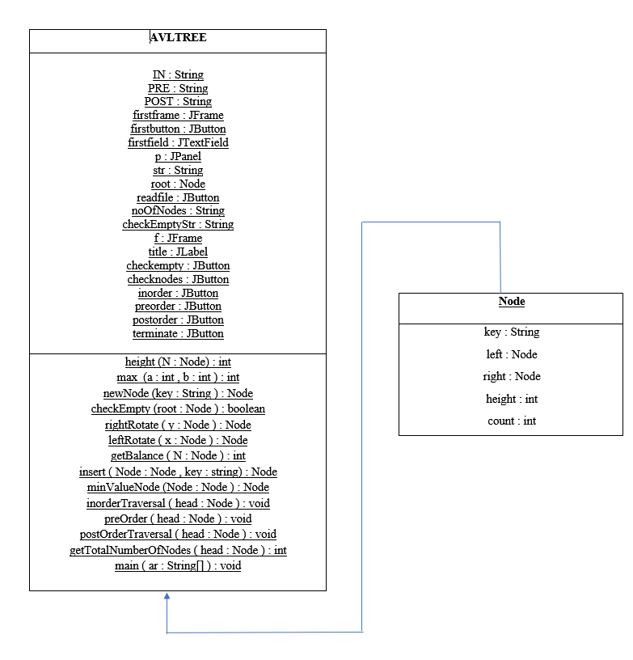
Class Diagram

Slide 8
LIVE DEMONSTARTION

Slide 9
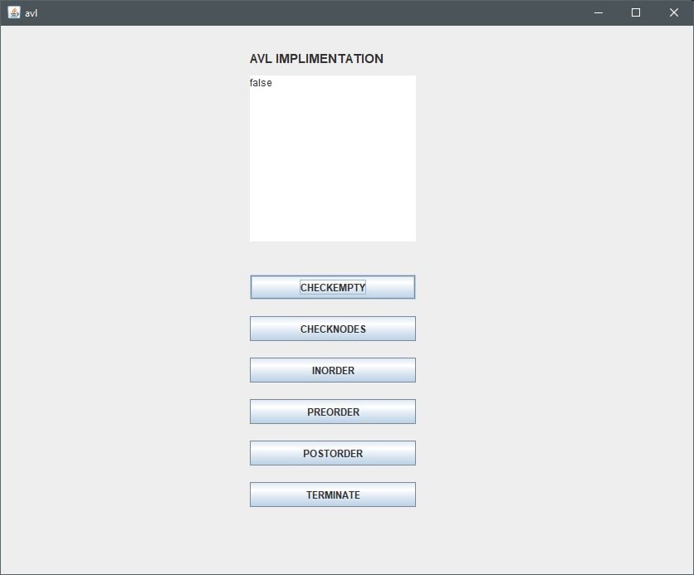
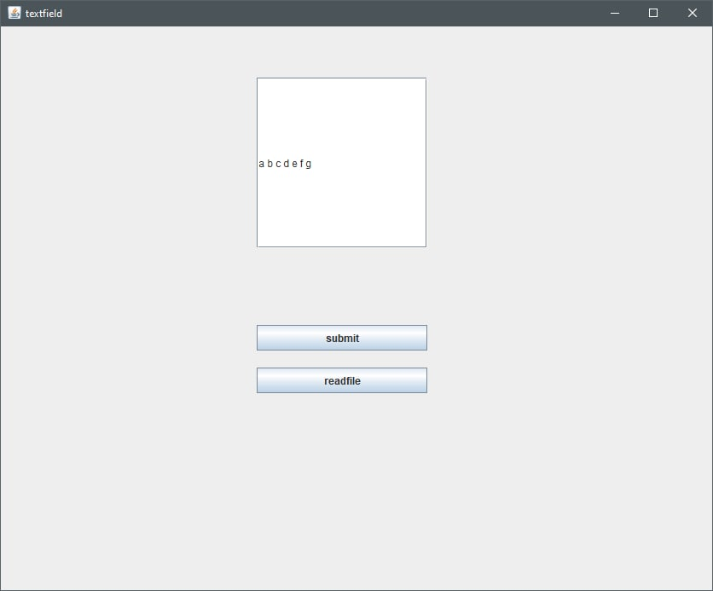
\
OUTPUT SCREENSHOTS

Slide 10
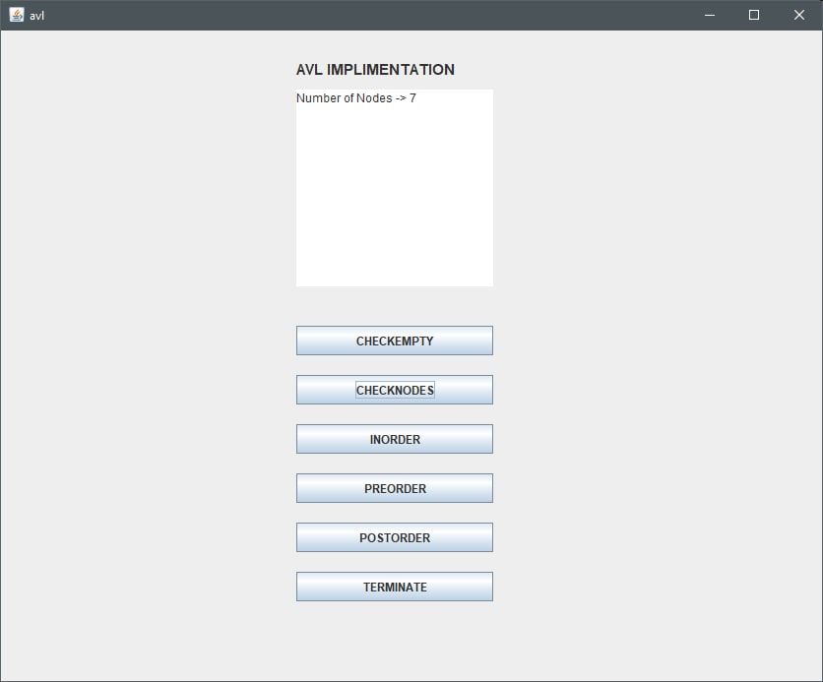
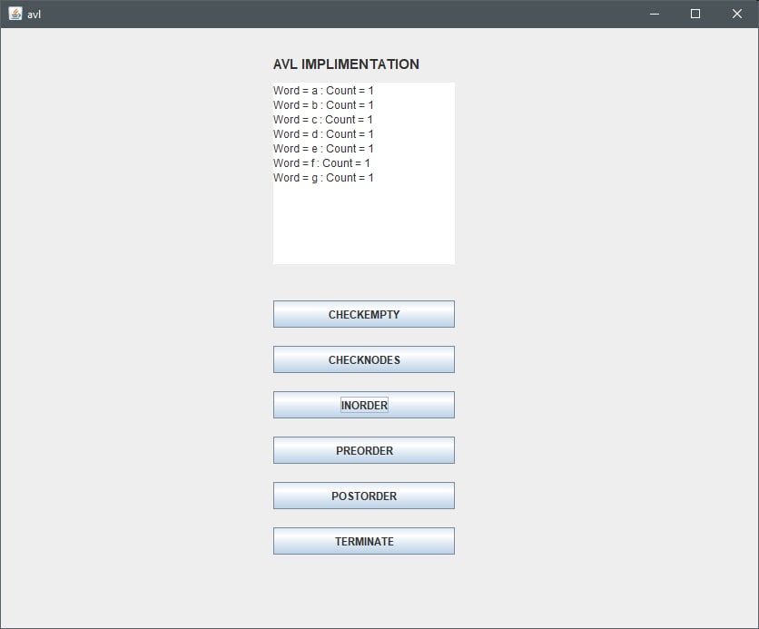
CHECK NODES
INORDER

Slide 11
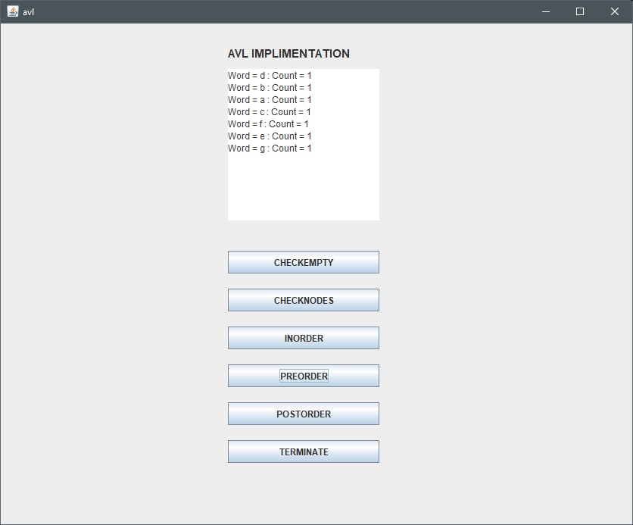

PREORDER
POSTORDER

Slide 12
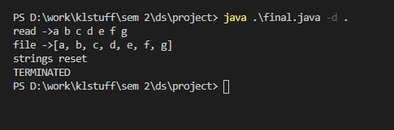
IDE INTERFACE

Slide 13

INTERACTION

Slide 14


